Slide 1
Business Performance Analysis
Growth Analyst Case Study — 16-Month Snapshot
Presented By
Olaewe Olufunmilola Olapeju BSc, MSc Statistics

Slide 2
TABLE OF CONTENT
01OBJECTIVES
02
APPROACH & METHODOLOGY
03 KEY KPI DASHBOARD
04 INSIGHTS & OBSERVATION
05 CONCLUSIONS & RECOMMENDATIONS

Slide 3
OBJECTIVES
This analysis aims to uncover key insights into the business performance of Kuda over the past 16 months: Specifically, the goal is to
Identify 4 key growth and revenue KPI.
Explain their impact on business performance.
Highlight trends and actionable insights.
Support data-driven decisions for marketing, product, and customer growth.
This analysis helps focus on metrics that drive sustainable growth.

Slide 4



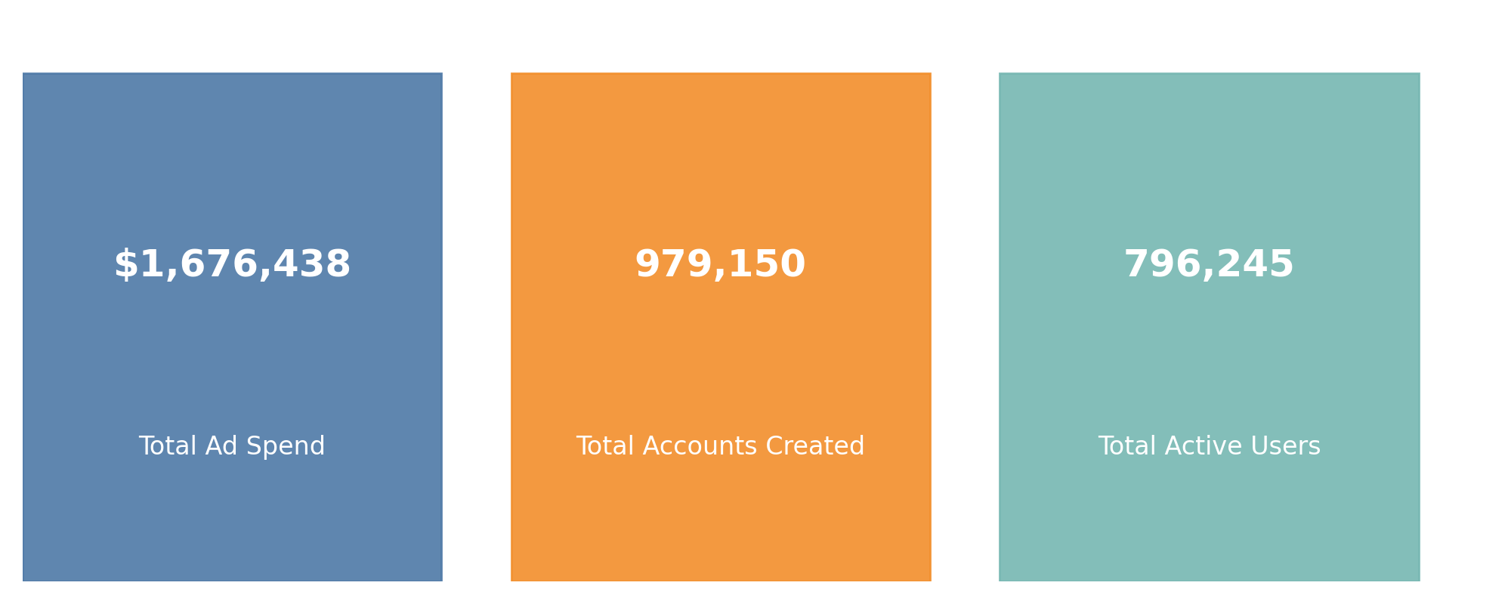
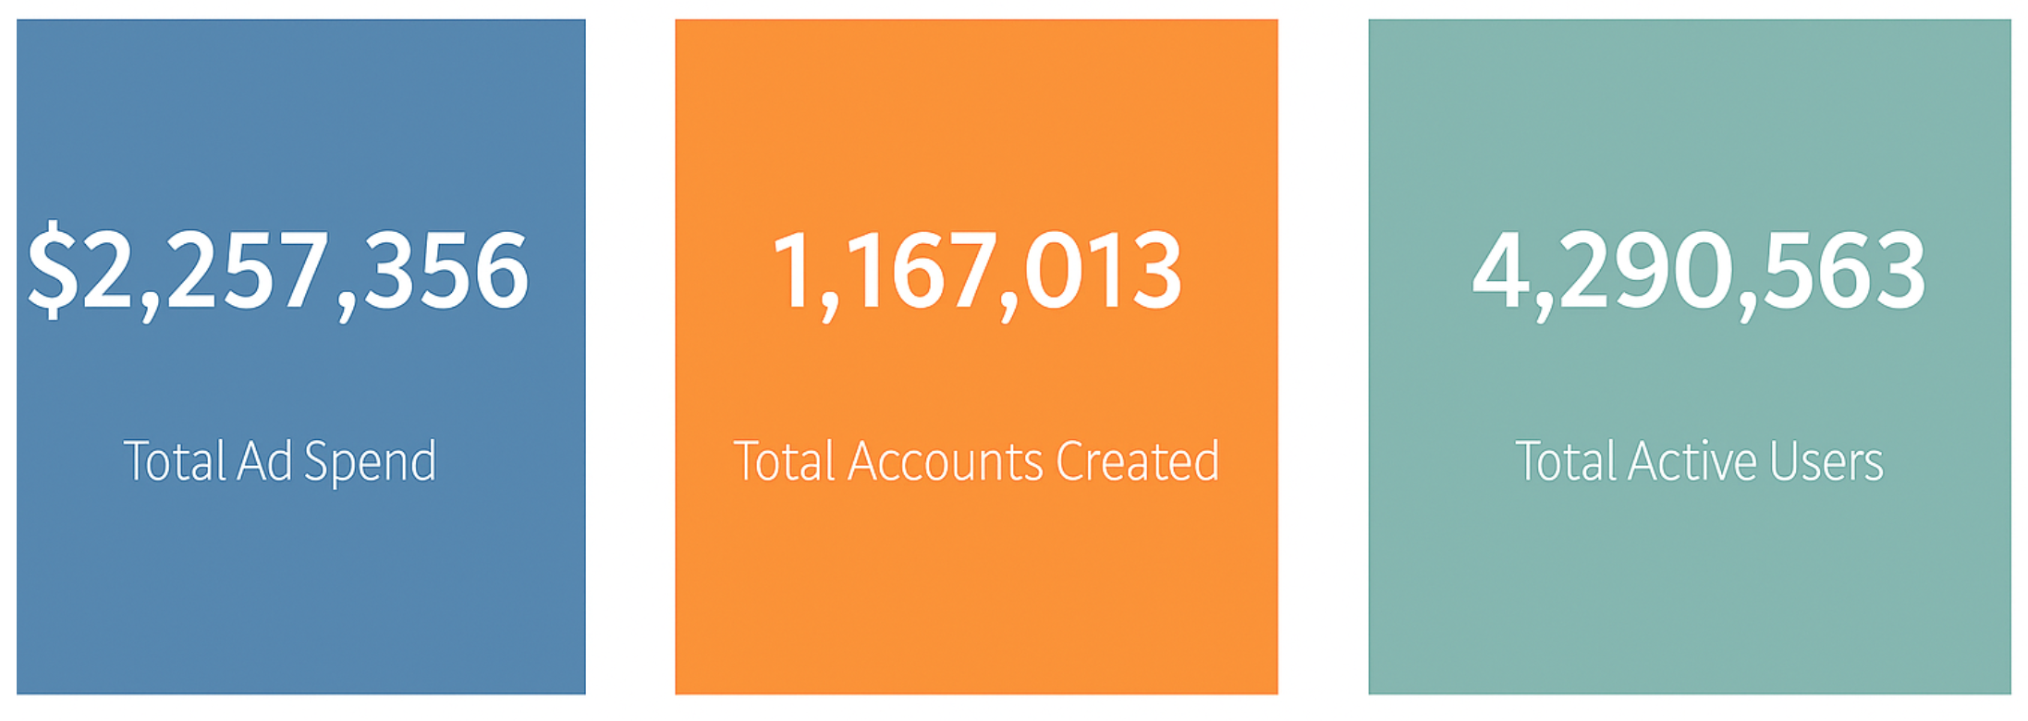
INSIGHTS FROM BUSINESS PERFORMANCE ANALYSIS
REPORT SUMMARY

Slide 5
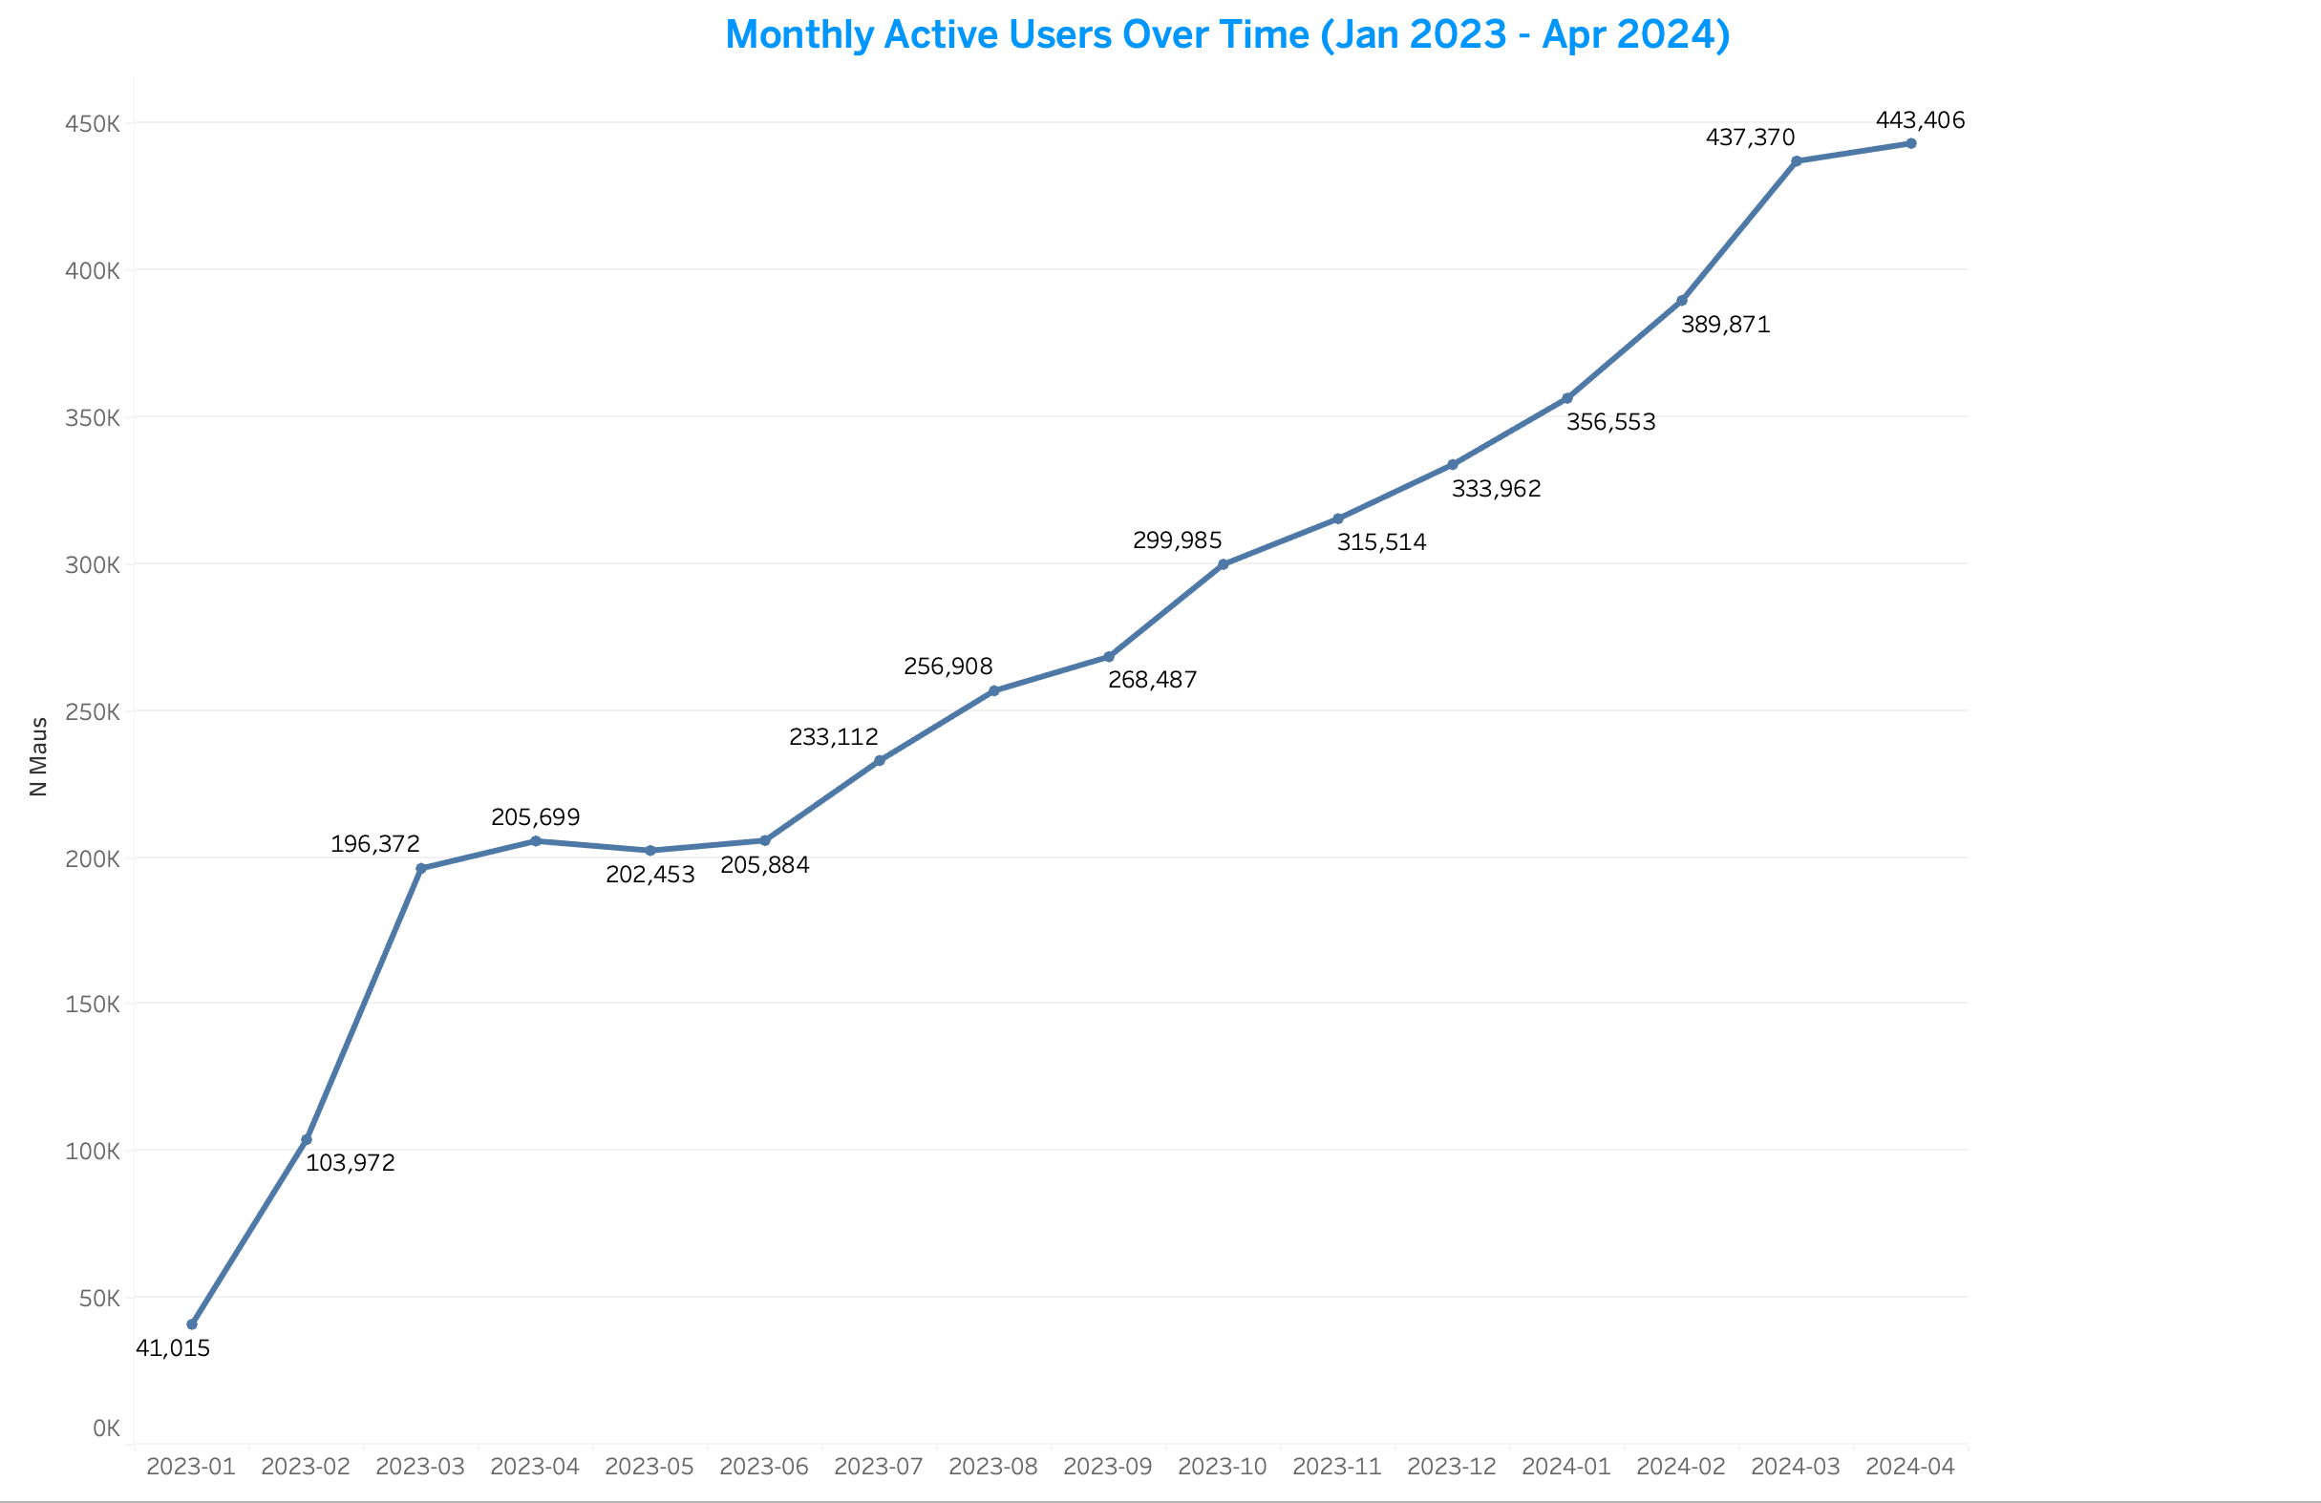
INSIGHTS FROM BUSINESS PERFORMANCE ANALYSIS

Slide 6
INSIGHTS FROM BUSINESS PERFORMANCE ANALYSIS
Why MAU Over time Mattters
MAU over time is a core growth metric to know if the company is acquiring and keeping users.
As a Growth Data Analyst, MAUs is a core growth indicator to show if the product is attracting and retaining an active user base over time. Tracking MAUs highlights trends in user engagement and adoption.
How it was Calculated
I have the sum of MAU for each month plotted against the Transaction Month (n_maus per transaction_month).
n_maus field, aggregated by Transaction Month.
Visualized as line chart showing monthly trend.
Insight
The Monthly Active User base has grown steadily from 40,000 to over 440,000 in the last 16 months, representing a sustained upward trend in user engagement.

Slide 7
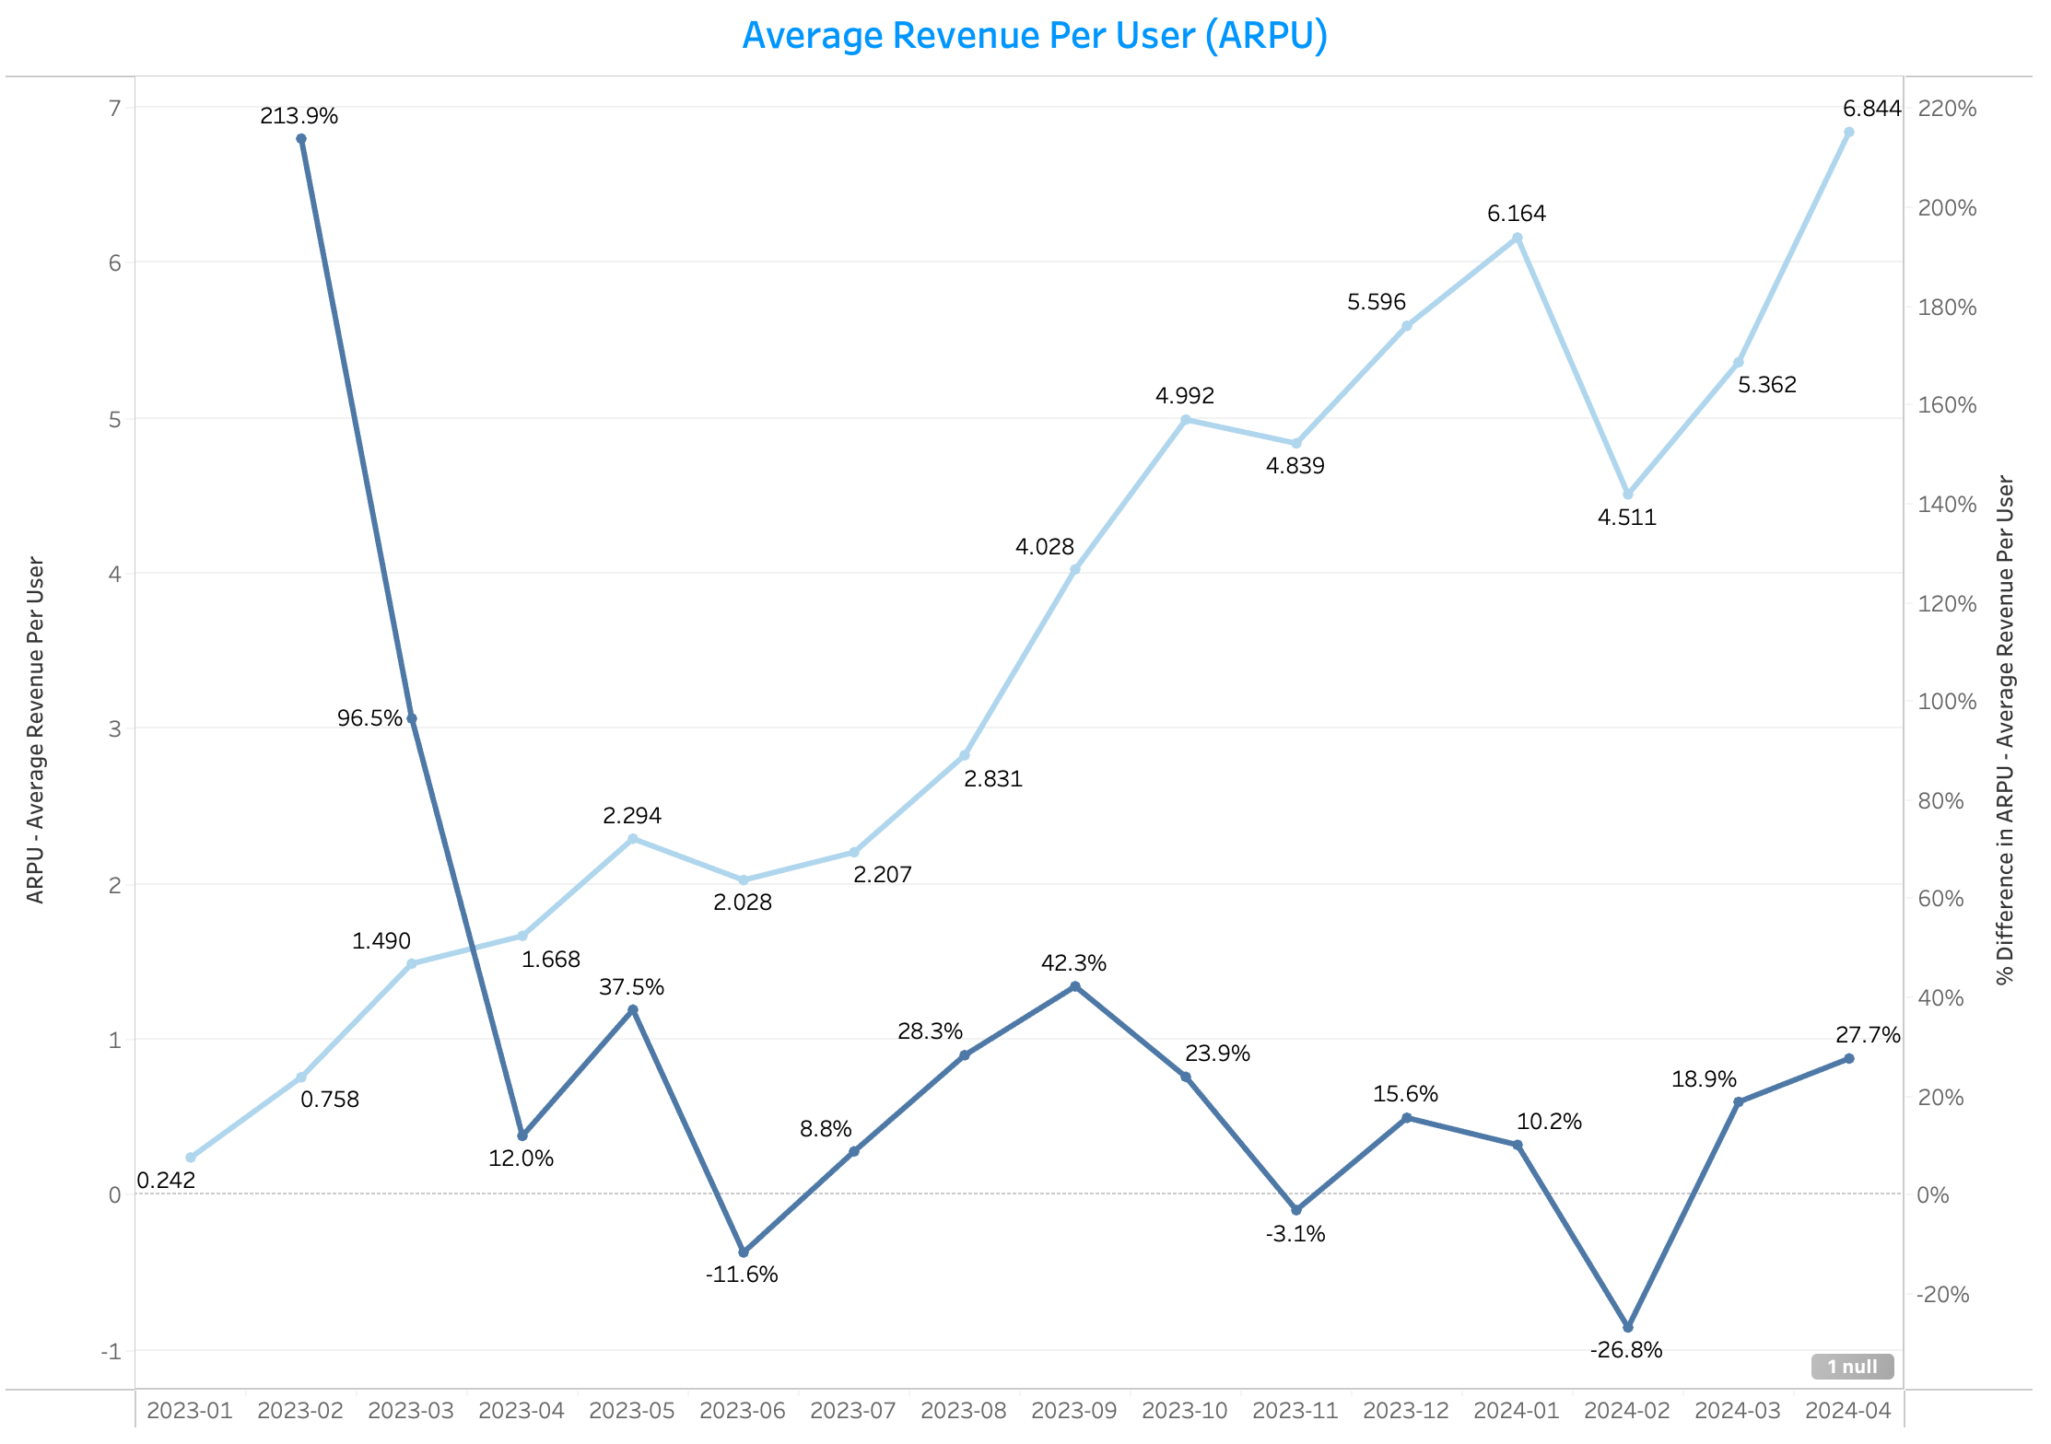
INSIGHTS FROM BUSINESS PERFORMANCE ANALYSIS
NOTE: Sky Blue Line → ARPU (Average Revenue Per User)
Navy Blue Line→ % Difference in ARPU (Month-over-Month Growth Rate)

Slide 8
INSIGHTS FROM BUSINESS PERFORMANCE ANALYSIS
Why AVERAGE REVENUE PER USER (ARPU) Matters
Average Revenue Per User (ARPU) measures monetization efficiency — how much revenue is generated per active user. This is key to understanding if growth is translating into sustainable revenue, which is critical for business performance.
How it was Calculated
Formula: ARPU = total_revenue_usd / n_maus
In this case: field ARPU provided — plotted by Transaction Month.
Shown as line chart with % difference to track growth rate.
Insight
The upward trend of ARPU indicate that users are generating more revenue per person over time. Starting from a low base of $0.24 in Jan 2023, ARPU consistently grew to $6.84 by Apr 2024 — a remarkable 27x growth.
MAUs were growing (user base expansion), the business successfully increased revenue per user — signaling improved monetization strategies (e.g. pricing, upsell, better engagement). This is a positive signal for sustainable revenue growth.

Slide 9
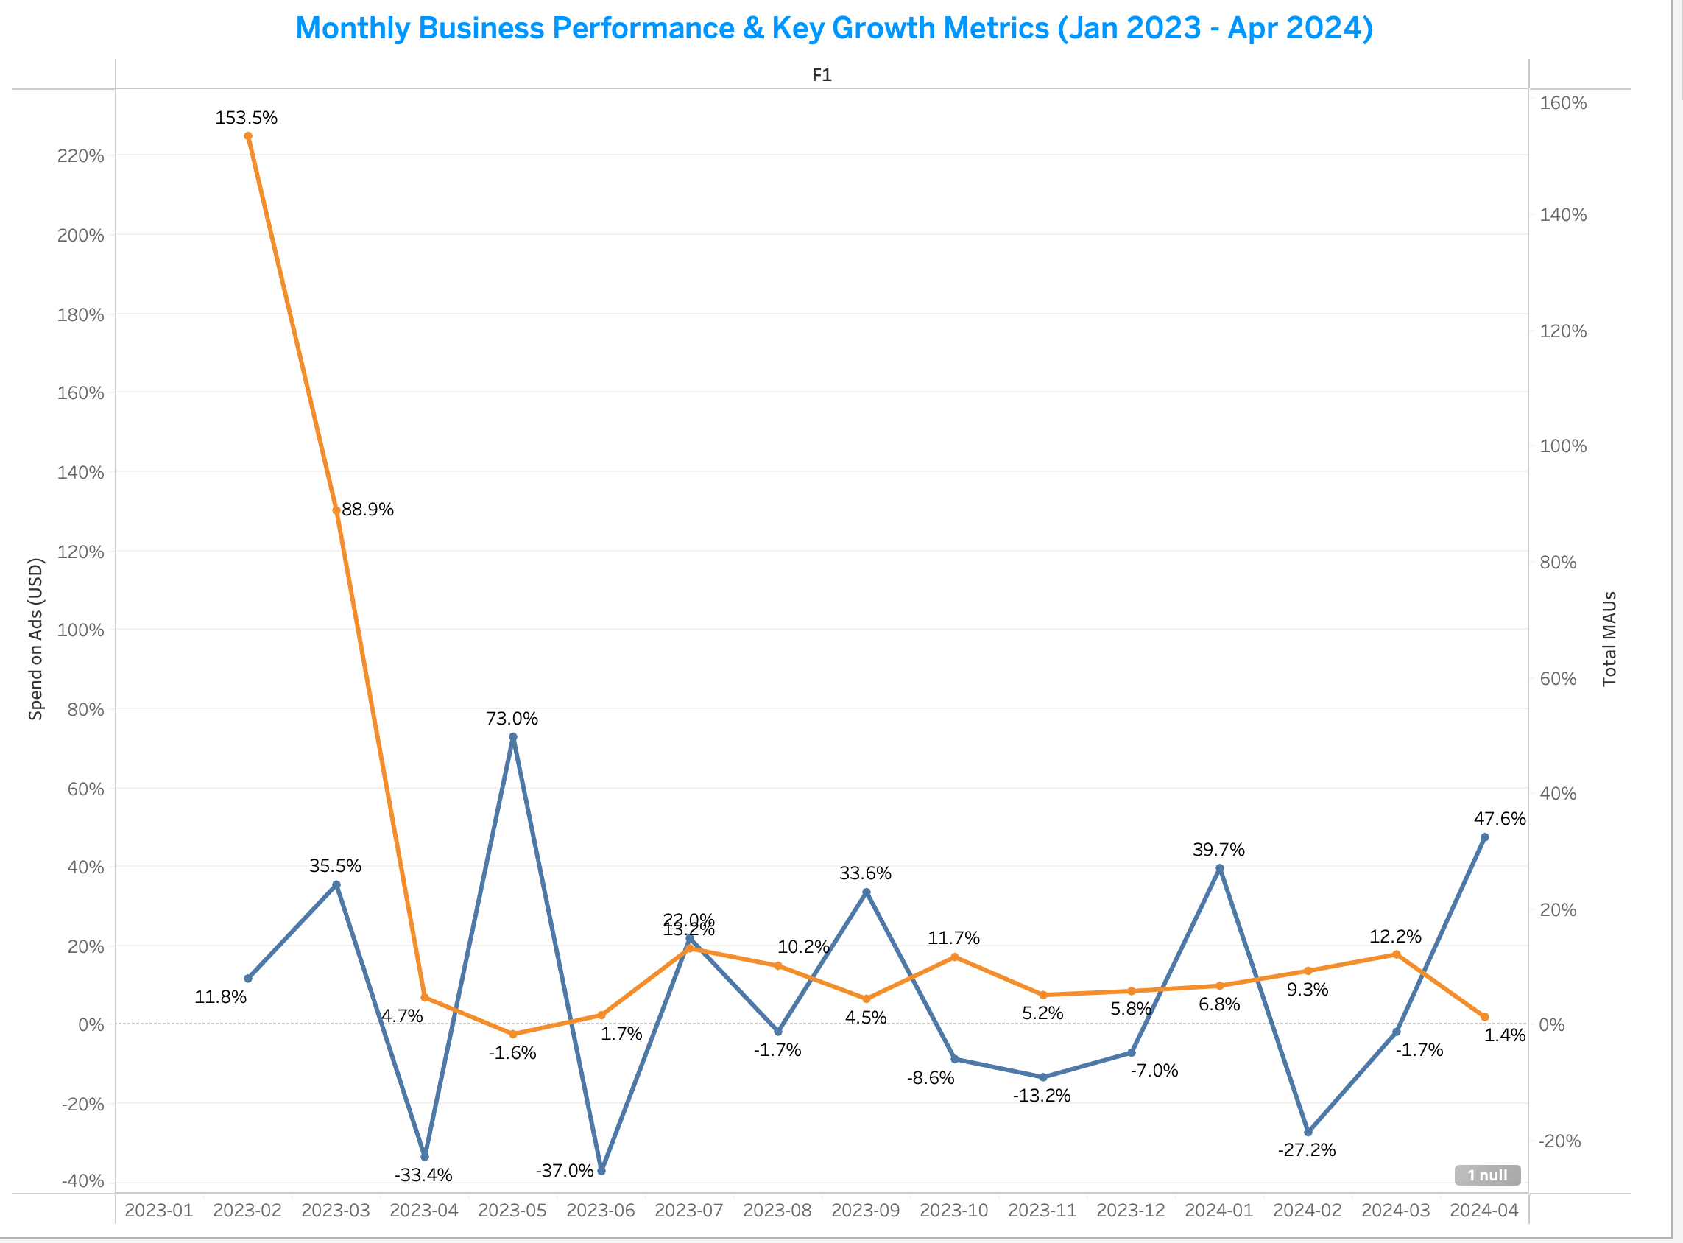
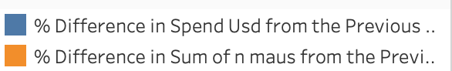

Slide 10
INSIGHTS FROM BUSINESS PERFORMANCE ANALYSIS
Monthly % Change in Ad Spend vs. MAUs (Jan 2023 - Apr 2024)
Chosen KPIs
KPIs: Monthly Percentage Change in Ad Spend (USD) and Total Monthly Active Users (MAUs).
Why Chosen: To directly assess the relationship and efficiency between marketing investment and user growth momentum.
How it was Calculated
Calculated as the month-over-month percentage difference for both Ad Spend and MAUs.
% Difference Formular in Tableau –
(ZN(SUM([N Maus])) - LOOKUP(ZN(SUM([N Maus])), -1))
/ LOOKUP(ZN(SUM([N Maus])), -1) * 100
Insights
MAU growth experienced initial hyper-spikes, then stabilized to consistent positive monthly gains.
Ad Spend percentage change was highly volatile throughout the period.
Beyond early months, large ad spend swings did not directly translate to proportional MAU growth.

Slide 11
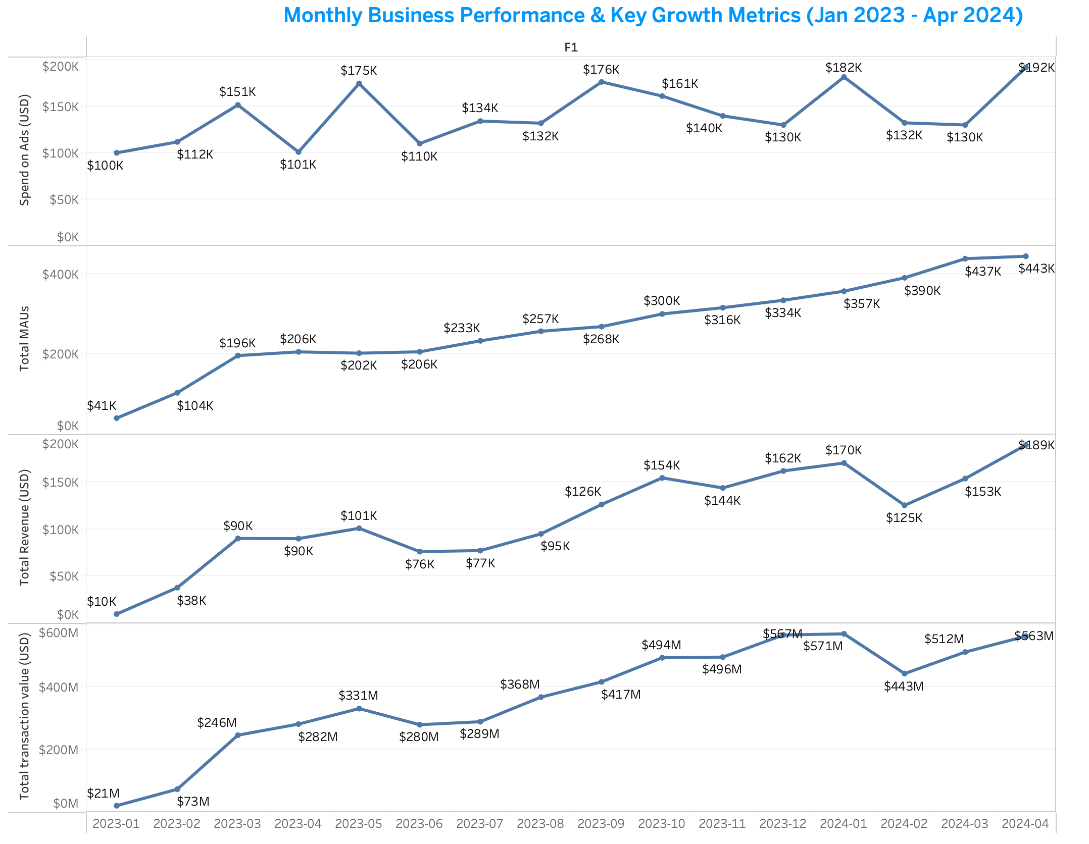
INSIGHTS FROM BUSINESS PERFORMANCE ANALYSIS

Slide 12
INSIGHTS FROM BUSINESS PERFORMANCE ANALYSIS
Chosen KPIs & Why (As Growth Data Analyst)
KPIs: Spend (USD), n_maus (Monthly Active Users), total revenue usd, total transaction value usd.
Why Chosen: As a Growth Data Analyst, these KPIs are fundamental for assessing overall platform health and growth. They directly measure user engagement, financial performance, and the scale of platform activity, indicating acquisition, retention, and monetization effectiveness.
How it was Calculated
Spend: Total ad/marketing spend per month (calculated monthly).
Sum of n_maus: Total unique Monthly Active Users (MAU) for each month.
Sum of total revenue usd: Total revenue generated in USD per month.
Sum of total transaction value usd: Total gross value of all transactions in USD per month.
All metrics are aggregated monthly.

Slide 13
INSIGHTS FROM BUSINESS PERFORMANCE ANALYSIS
Insights
Strong, Consistent Growth: All four key metrics show a significant and consistent upward trend from early 2023 to April 2024, indicating robust business growth.
MAU as Growth Driver: Monthly Active Users (MAU) consistently increased, driving corresponding growth in transactions and total transaction value.
Revenue Growth: Revenue also shows strong growth, albeit with some monthly fluctuations (e.g., Q1 2024 dip from Dec 2023 peak).
Spend Volatility: Spend exhibits more volatility month-to-month compared to other metrics, with peaks (e.g., Oct 2023, April 2024) followed by dips, but the overall trend is upward. This suggests active marketing efforts tied to growth.

Slide 14
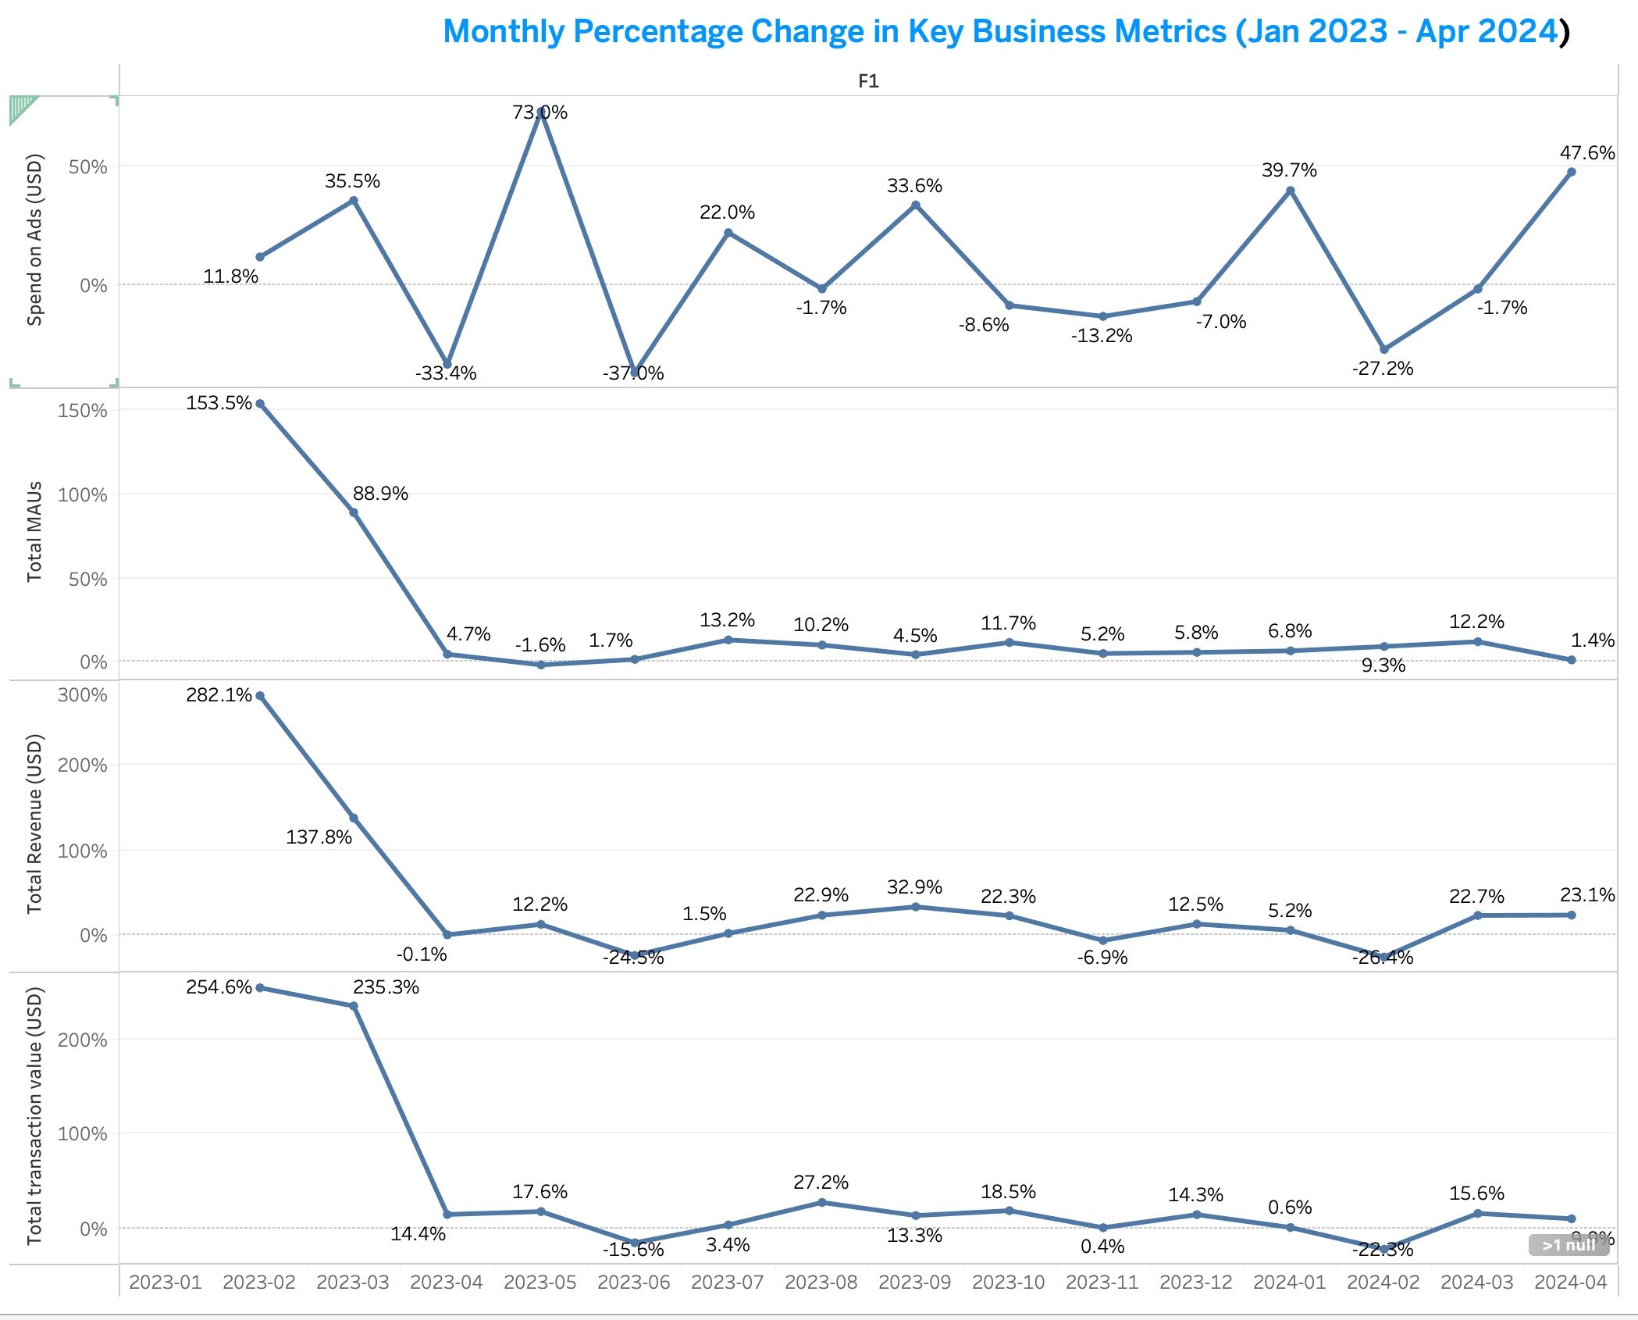
INSIGHTS FROM BUSINESS PERFORMANCE ANALYSIS

Slide 15
INSIGHTS FROM BUSINESS PERFORMANCE ANALYSIS
Monthly KPI % Change Analysis (Jan 2023 - Apr 2024)
What This Shows:
KPIs: Monthly % change in Spend, Monthly Active Users (MAU), Total Revenue, and Total Transaction Value.
Why: Measures the momentum and efficiency of our growth.
Insights
Initial Hyper-Growth: MAU, Revenue, and Transaction Value saw massive early gains, now stabilizing to consistent positive monthly growth.
Spend & Metric Volatility: Ad Spend shows high monthly fluctuations, and all metrics experience significant shifts that require deeper investigation.

Slide 16
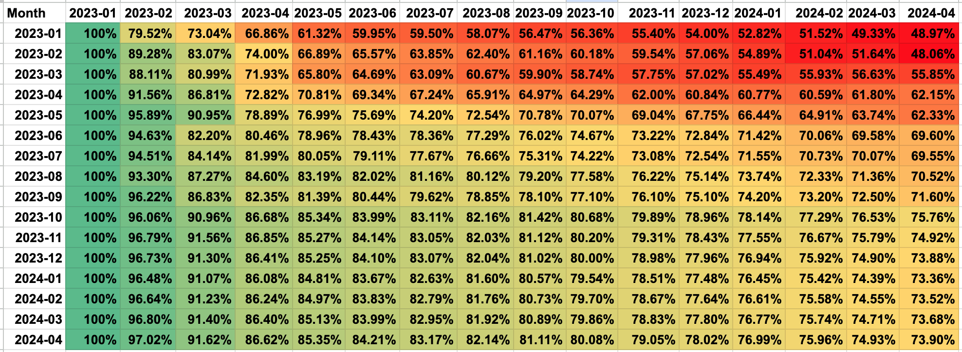
INSIGHTS FROM BUSINESS PERFORMANCE ANALYSIS
RETENTION ANALSYSIS

Slide 17
INSIGHTS FROM BUSINESS PERFORMANCE ANALYSIS
Why Retention Matters
Essential for tracking user stickiness and long-term value, showing if the company is keeping users.
% of users from cohort who are still MAUs in later months.
How It was Calculated
Calculated as the percentage of initial users (cohorts) active in following months, displayed in a percentage table/heatmap.
Retention Rate = (Initial Cohort Size (Users in Acquisition Month)Number of Active Users from Cohort in Current Month​)×100%
Insights
Newer customer groups are retaining much better, though the biggest user drop still happens in the very first month. Overall, we have strong long-term customer loyalty.

Slide 18
CONCLUSION & RECOMMENDATIONS
Conclusion
The business is experiencing steady growth in users, revenue, and transactions.
ARPU has significantly increased, indicating improved monetization.
Marketing spend is effective but volatile.
Recommendations
Focus on initiatives that further increase ARPU.
Optimize and stabilize marketing spend.
Improve onboarding to boost first-month retention.
Monitor marketing efficiency and retention trends regularly.

Slide 19
APPENDIX
Other KPI included in this Report
Customer Acquisition Cost (CAC) CAC = spend_usd / n_accounts_created
Conversation rate from Installation to owning an account Conversion Rate = n_accounts_created / n_installs
Installation Cost
Installation cost (Cost per app install) = spend_usd / n_installs

Slide 20
THANK YOU

